Slide 1
Regression 3: Linear Probability Model
UIUC ECON 474 Econometrics of Policy Evaluation

Slide 2
Overview
Next time: Intro to R Markdown
Installation if you have not done so already
Today:
Recap big picture questions economists are interested in answering
Relate economic questions to logistic regression vs. OLS debate
Foreshadow causal identification issues we will address
Lab: practice Logit and OLS marginal effects

Slide 3

Why economists require econometrics.
Providing precise numbers to causal relationships between $x$ and $y$

Slide 4
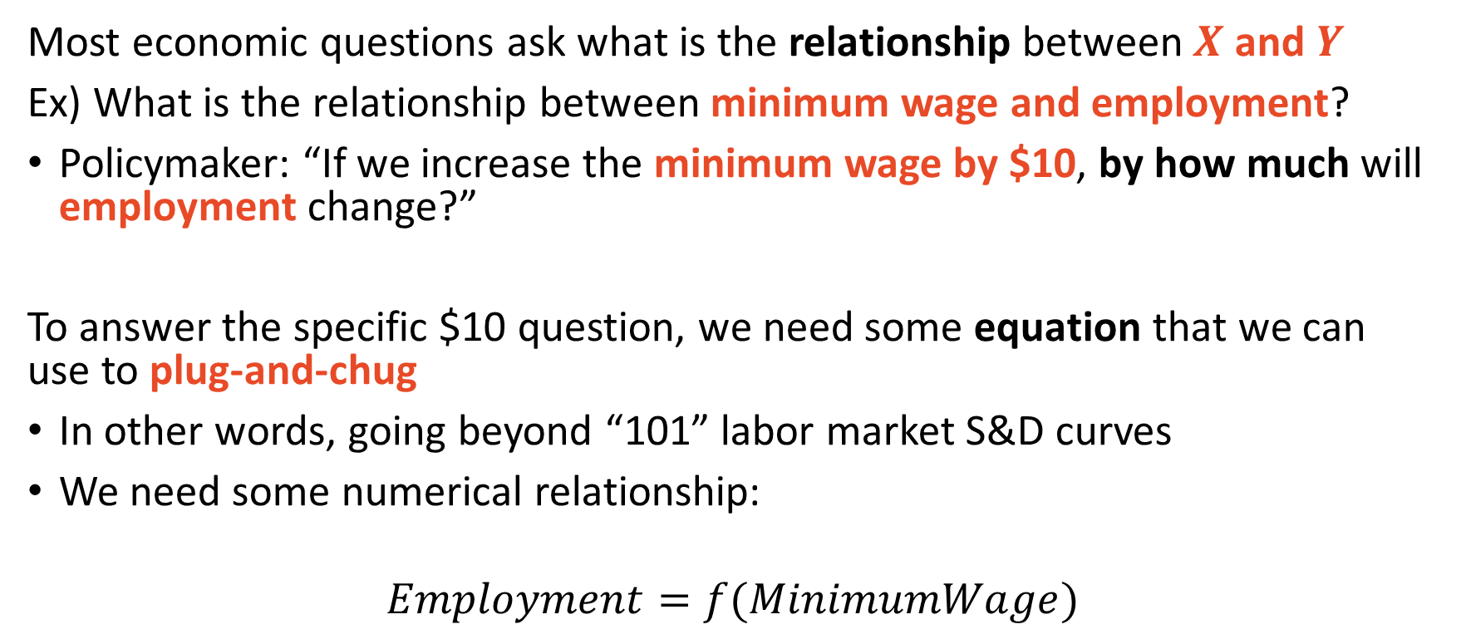
Answering econ questions require equations
Most economic questions ask what is the relationship between $X$ and $Y$
Ex) What is the relationship between minimum wage and employment?
Policymaker: “If we increase the minimum wage by $10, by how much will employment change?”
To answer the specific $10 question, we need some equation that we can use to plug-and-chug
In other words, going beyond “101” labor market S&D curves
We need some numerical relationship:
$$Employment=f(MinimumWage)$$

Slide 5
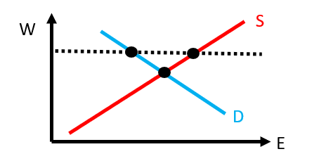
Econometrics tests economic theory
All sciences require theory and observational data
Theory generates mathematical models
Econometrics tests theoretical predictions and relationships
Does increasing minimum wage (a price floor) decrease employment?
“101” logic:
101 theory predicts a decrease in employment

Slide 6
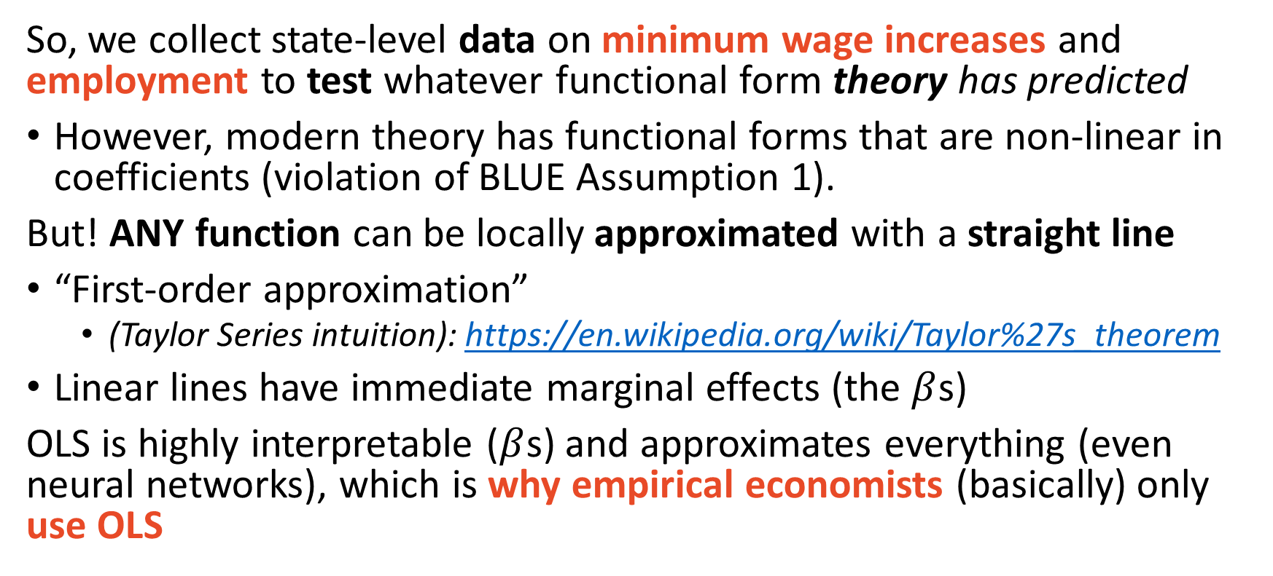
Linear lines first-order approximate ANY function
So, we collect state-level data on minimum wage increases and employment to test whatever functional form theory has predicted
However, modern theory has functional forms that are non-linear in coefficients (violation of BLUE Assumption 1).
But! ANY function can be locally approximated with a straight line
“First-order approximation”
(Taylor Series intuition): https://en.wikipedia.org/wiki/Taylor%27s_theorem
Linear lines have immediate marginal effects (the $β$s)
OLS is highly interpretable ($β$s) and approximates everything (even neural networks), which is why empirical economists (basically) only use OLS

Slide 7
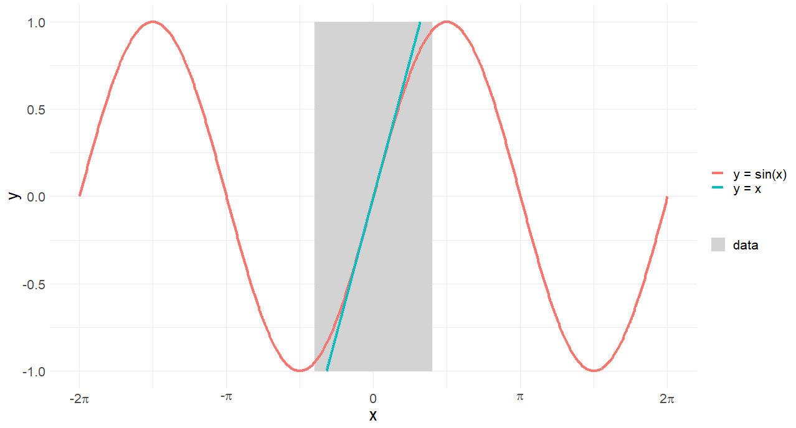
Ex) sine curves are locally approximated by linear lines

Slide 8
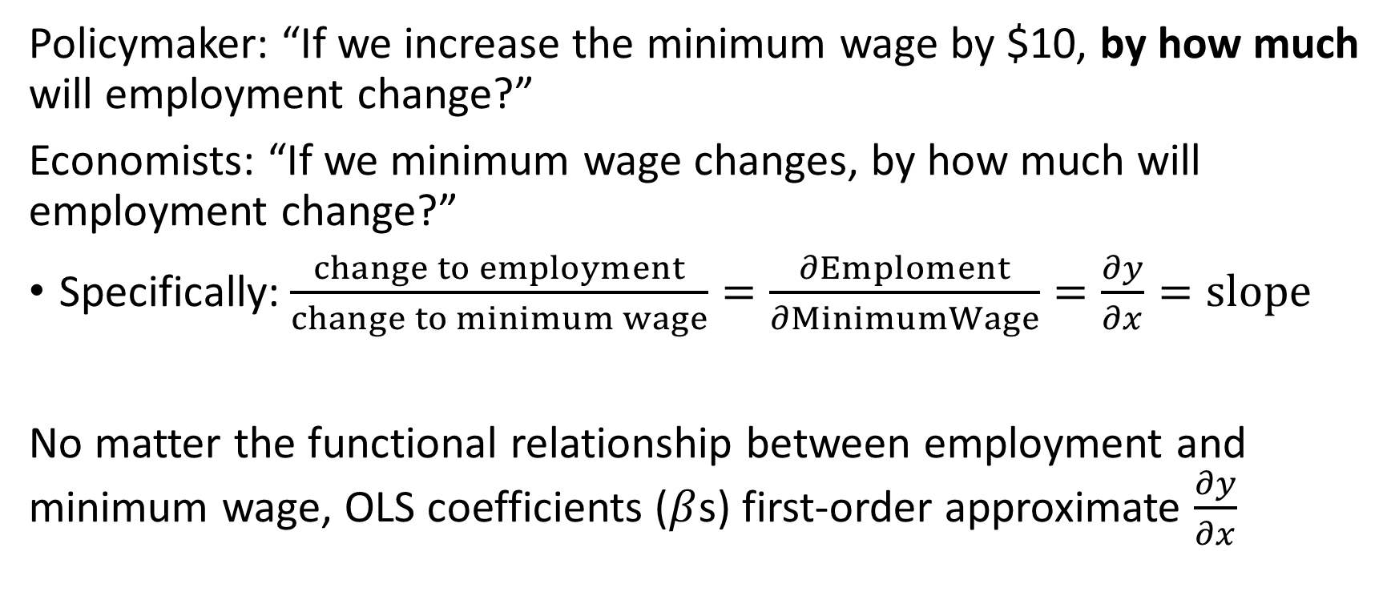
OLS approximates any $x$ and $y$ relationship
Policymaker: “If we increase the minimum wage by $10, by how much will employment change?”
Economists: “If we minimum wage changes, by how much will employment change?”
Specifically: $\frac{change to employment}{change to minimum wage}=\frac{∂Emploment}{∂MinimumWage}=\frac{∂y}{∂x}=slope$
No matter the functional relationship between employment and minimum wage, OLS coefficients ($β$s) first-order approximate $\frac{∂y}{∂x}$

Slide 9
Do we need logistic regression for binary outcomes?
Well, maybe.

Slide 10
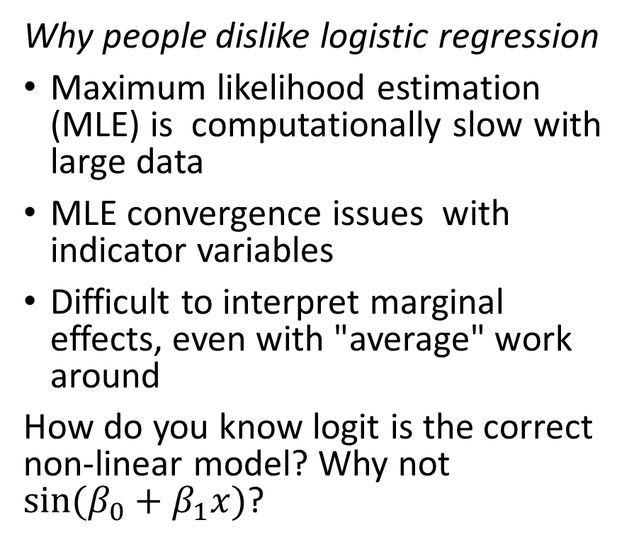
Logistic regression may not be the “right” model
Why people like logistic regression
The predictions are bounded between zero and one
Functional form is backed by economic choice models
Ex) modelling which college major students choose
Logit is statistically accurate if it is the "correct" non-linear model
Why people dislike logistic regression
Maximum likelihood estimation (MLE) is computationally slow with large data
MLE convergence issues with indicator variables
Difficult to interpret marginal effects, even with "average" work around
How do you know logit is the correct non-linear model? Why not $sin⁡(β_{0}+β_{1}x)$?

Slide 11
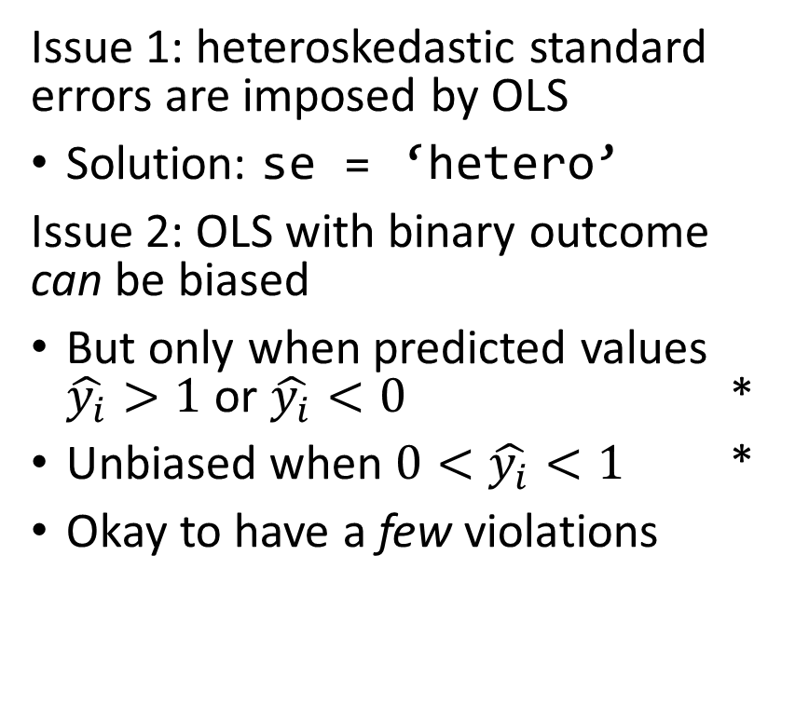
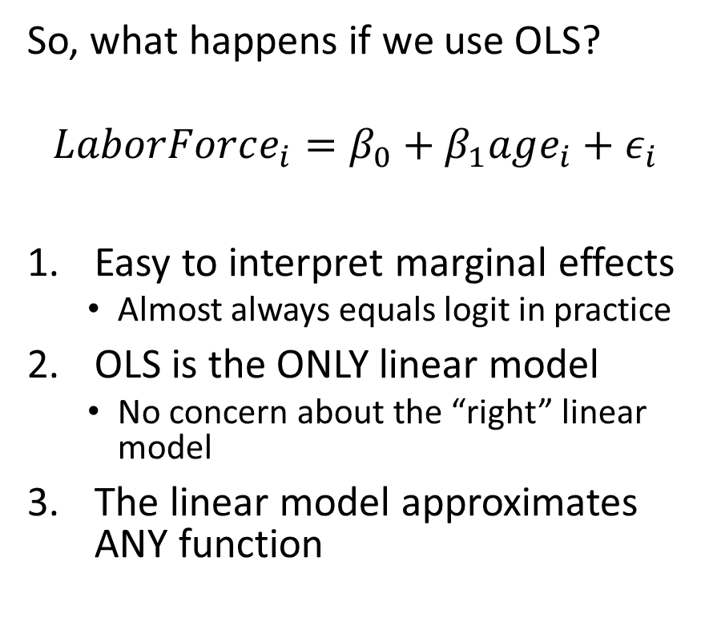
OLS and Logit tend to have similar marginal effects
So, what happens if we use OLS?
$$LaborForce_{i}=β_{0}+β_{1}age_{i}+ε_{i}$$
Easy to interpret marginal effects
Almost always equals logit in practice
OLS is the ONLY linear model
No concern about the “right” linear model
The linear model approximates ANY function
Issue 1: heteroskedastic standard errors are imposed by OLS
Solution: se = ‘hetero’
Issue 2: OLS with binary outcome can be biased
But only when predicted values $\hat{y_{i}}>1$ or $\hat{y_{i}}<0$ *
Unbiased when $0<\hat{y_{i}}<1$ *
Okay to have a few violations
* Source: Horace and Oaxaca (2006)

Slide 12
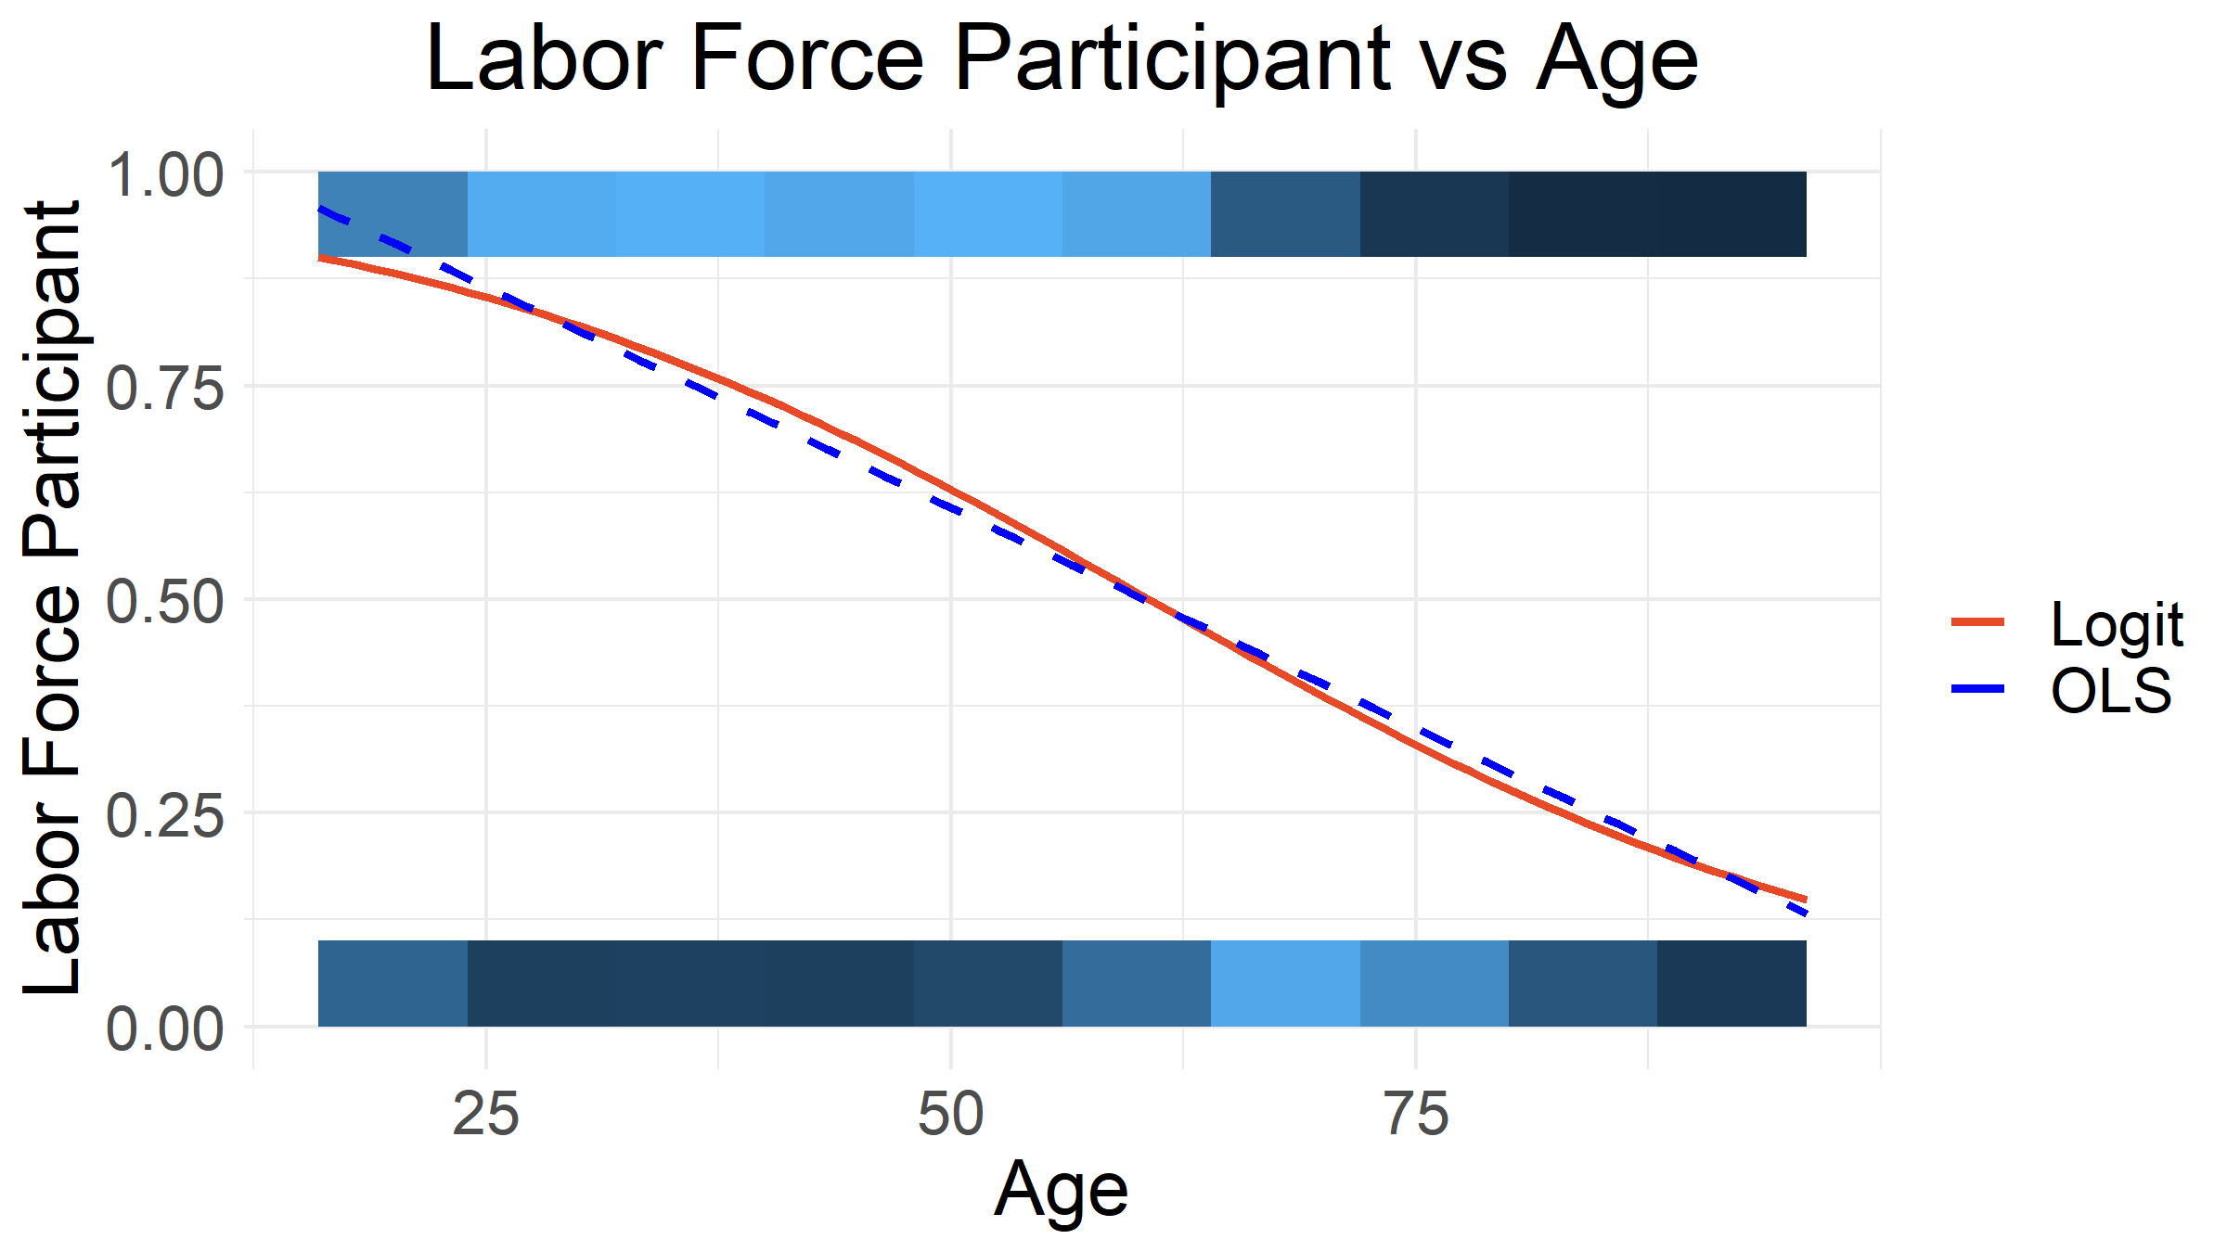
Ex) All OLS $\hat{y_{i}}$ bounded between 0 and 1 (unbiased)

Slide 13
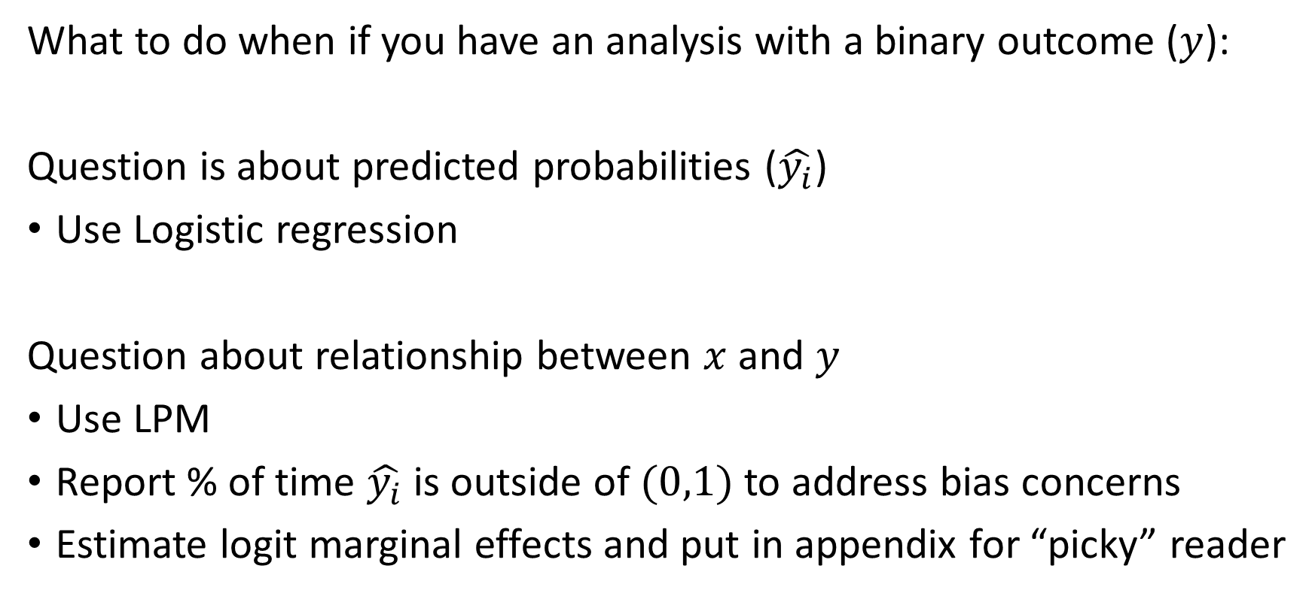
When to use LPM vs. Logistic Regressoin
What to do when if you have an analysis with a binary outcome ($y$):
Question is about predicted probabilities ($\hat{y_{i}}$)
Use Logistic regression
Question about relationship between $x$ and $y$
Use LPM
Report % of time $\hat{y_{i}}$ is outside of $(0,1)$ to address bias concerns
Estimate logit marginal effects and put in appendix for “picky” reader

Slide 14
A quick causal sidebar
A preview of what’s to come in ECON 474

Slide 15
Issues we are addressing this semester
Collecting data on states that increased the minimum wage and looking at the changing employment levels is insufficient to answer
"If we increase the minimum wage by $10, by how much will employment change?“
Naïve regression hides:
Omitted economic events that affect employment levels
Ex) The policy change could coincide with a recession
Minimum wage changes are non-random (endogenous: a choice)
Ex) The policy could be in response to a great resignation of low-wage workers
There is not a clear control group for states with policy change
Need observations that represent the counterfactual (no policy change)

Slide 16
A surprising result!
To answer the running question, if there is market power
(e.g. companies operating like monopolies, companies that can influence prices, etc…),
then increasing a sufficiently low minimum wage will increase employment!
This is the case in the United States!
A fantastic example of econometrics contradicting “101” theory
Card and Krueger (1994) Minimum Wages and Employment
Card and Krueger (1995) Myth and Measurement: Minimum Wage
Bhaksar, Manning, and To (2002) Oligopsony in Labor Markets
A great general audience book on market power: The Profit Paradox by Jan Eeckhout

Slide 17
Lab: today’s coding example
Comparing logistic regression to the linear probability model

Slide 18
Practice, practice, practice
Lab!
Copy and paste the code of last lecture up to estimating that marginal effects of fit2
Estimate LPM equivalents for fit1 and fit2
Compare marginal effects
Report what proportion of the time LPM models predict values outside of (0, 1) to address potential bias

